Slide 1
WASTE To WOW
Team 7
Home Waste Management Recommendation System - Recycling or Upcycling

Slide 2
Table of Contents.
01 | Data Analytics and
Intelligent System Integration
02 | System Evaluation and Visualization
03 | Code Walkthrough
04 | Demo

Slide 3
Data Analytics and
Intelligent System Integration
Krishna Sameera Surapaneni

Slide 4
System Requirement Analysis
Actors:
Individuals or organizations interacting with the system, providing data inputs, receiving recommendations, and accessing waste management information.
Use Cases:
Waste Classification: The system processes data from various sources such as images, sensors, and text inputs to classify waste accurately into categories such as recyclable, non-recyclable, hazardous, organic, etc.
Recommendation Generation: Based on the classified waste data, the system generates recommendations for proper waste management practices, including recycling options, disposal methods, and potential reuse opportunities.

Slide 5
High-level Data Analytics and Machine Learning Functions
Objective: Develop an intelligent garbage classification and waste management system for addressing improper household waste disposal.
ML Model: Advanced ML model like YOLOv8 is employed for accurate garbage classification. ML function is specifically trained on garbage-related characteristics during elicitation.
Recommendation: Provides tailored recommendations for disposal methods (recycling, upcycling, donation). Real-time user interface is deployed for garbage classification, with Google Maps API integration.

Slide 6
System Design
Users interact through a user interface connected to camera-equipped devices like smartphones or laptops.
Captured waste images are transmitted to the backend system for classification using YOLOv8 algorithms.
YOLOv8 precisely identifies waste categories such as hazardous, biodegradable, recyclable, etc.
Language Model (LLM) integrated provides disposal, recycling, or upcycling recommendations based on waste classification.
Delivers recommendations and classifications back to the user interface alongside the waste image.
Leverages connectivity to integrate with external resources like the Google Maps API for accessing safe disposal locations.

Slide 7
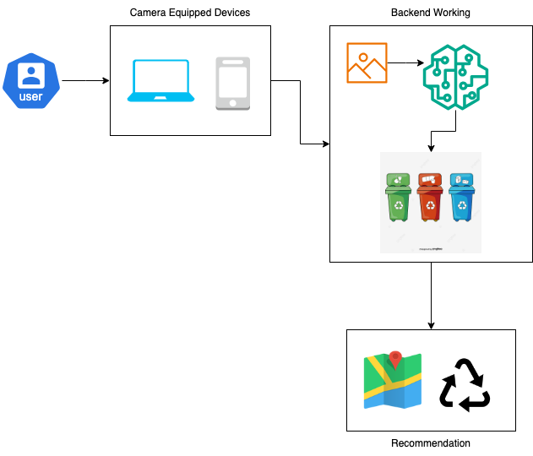
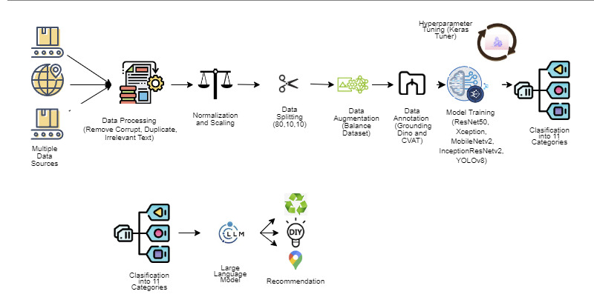
System Design

Slide 8
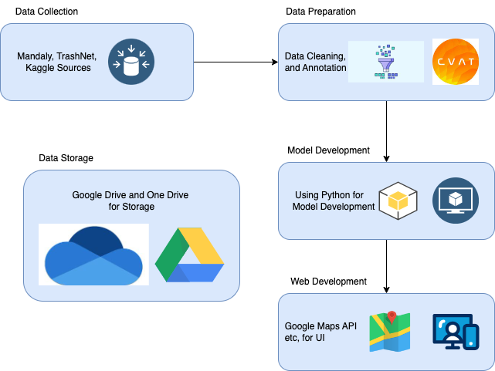
System Supporting Platforms, Cloud Environment and Data Repository
Data Storage and Management Platforms: Relied on Google Drive for storing and managing diverse image datasets sourced from platforms like Mendeley and TrashNet.
Machine Learning Frameworks: Utilized TensorFlow or PyTorch for developing and deploying sophisticated ML models (Xception, ResNet-50, YOLOv8 etc).
Model Training and Inference: Utilized local computing resources (CPU/GPU) for model training and inference.
Collaborative Environment: Google Colab used for prototyping and experimenting with ML algorithms collaboratively.
Integration with External Resources: Google Maps API and Llama API to recommend nearby disposal facilities, recycling centers, or donation centers based on user location and upcycling techniques.

Slide 9
System Evaluation and Visualization
Siddharth Solanki

Slide 10
Analysis of Model Execution
and Evaluation Results
Comprehensive Assessment: Utilizes various metrics for classification and object detection models, including confusion matrix and mAP50, offering a thorough evaluation of performance.
Insightful Metrics: Derives accuracy, precision, recall, and F1 score from the confusion matrix for classification models, while emphasizing mAP50 for object detection, providing deep insights into model performance
Performance Highlights: ResNet50's F1-score of 0.91 and 91% accuracy for classification, and YOLOv8’s impressive mAP50 scores, showcasing high accuracy across diverse thresholds and classes.

Slide 11
Evaluation Results
Model | mAP50 | mAP 50-95 | Inference Time (ms)
YOLOv8-m (1100 images) | 0.579 | 0.409 | 0.6
YOLOv8-s | 0.745 | 0.699 | 1.7
YOLOv8-m | 0.827 | 0.773 | 2.7

Slide 12
Achievements and Constraints
Achievements: Significant progress made by incorporating real-life photos and enhancing infrastructure. Expanded dataset improves model performance, ensuring accurate waste classification in diverse environments.
Innovative Solutions: Development of an user-friendly interface empowers individuals in waste management. Linking household waste to relevant businesses promotes sustainability and environmentally conscious recycling habits.
Constraints: High-level categorization of waste items due to resource limitations. Priority given to broader categorization to function effectively within constraints.

Slide 13
System Quality Evaluation of Model Functions and Performance
Efficient Training: Overcame initial training challenges by scaling up resources. Reduced training time from a day to a couple of hours, enhancing system performance.
Response Time Optimization: System response time measured from item presentation to recommendation delivery. Typically, object detection takes 2.7 ms of inference time, while recommendations within 2-3 seconds.

Slide 14
Code Walkthrough
Sonali Arcot

Slide 15
Demo
Vidushi Bhati

Slide 16
Thank You
Slide Template by - Irene M. Pepperberg

